Slide 1
Cloud Prototyping SS19
Decentralized Energy Trading
Midterm Presentation

Slide 2

Table of Content
Motivation
Current implementation
Household processing unit
Blockchain
Utility contract
Live demo
Next steps

Slide 3




Motivation
EEG Umlage
Notes:
Current setting
Several actors: different Consumer, Prosumer
Prosumer sells energy to Utility with EEG Umlage
Consumer buys energy from Utility

Slide 4
Motivation
EEG Umlage
Notes:
EEG Subvention will be cut from 2020 on

Slide 5

Motivation
Notes:
Using solar panels will not be profitable for most households

Slide 6

Motivation
Notes:
Solution: Ethereum Blockchain as decentralized energy market
Proof of Authority Consensus
Households can trade energy with each other
Energy Utility is only used when Produced energy < Consumed energy
Makes solar panels profitable again

Slide 7
Current implementation

Slide 8

Architecture
Sensor
Sensor
Sensor
Data
Stream
Smart Meter
Notes:
We explain it along the data stream
Sensors of solar panel and energy consumption stream the data to hhs
Encapsulated as a smart meter
Send data periodically (currently every 30s)
Add component that signs the sensor data

Slide 9
Architecture
Household JS-Server
Sensor
Sensor
Parity Client
Sensor
Data
Stream
Database
User Interface
Smart Meter
Household Processing Unit
Notes:
NodeJS Server with Express.js as universal middleware
MongoDB to store Sensors Data (and Blockchain Data, explained later)
User Interface for Displaying Data to the user, data from Database via HHS
Parity Client as Interface to the Blockchain
Access to Blockchain

Slide 10
Household processing Unit
NodeJS Server with Express.js
MongoDB
Sensors Data
Blockchain Data
User Interface
Displaying Data
Parity Client
Access to Blockchain
Notes:
Not sure if displaying the HHUnit is good here. Looks too crowded.

Slide 11
Architecture
Collecting Deeds
Household JS-Server
dUtility
Sensor
Consume/Produce
Transactions
Lock/Unlock
Account
Sensor
Parity Client
Trigger Netting
Sensor
Validator Set
Data
Stream
Database
User Interface
Smart Meter
Household Processing Unit
Ethereum Blockchain
Notes:
Ethereum Proof of Authority Blockchain
Built on Parity
Smart Contracts
Validator Set
Settlement
Gas price for netting
Block rate → netting every 5 blocks

Slide 12
Blockchain
Ethereum Proof of Authority Blockchain
Built on Parity
Smart Contracts
Validator Set
Settlement

Slide 13
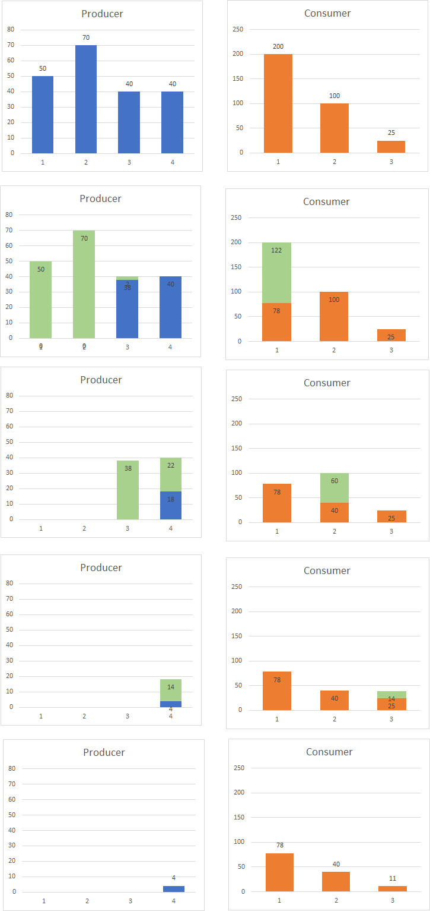
Settlement Algorithm
Notes:
TODO: Explain Settlement with picture overlay

Slide 14
NEtting Algorithm
Notes:
Two household groups. In this case more consumed than produced
we ensure that one household group (in this case the Producer)
we can guarantee to fulfill everyone's request

Slide 15
NEtting Algorithm
Notes:
because we want that all producing household's get a appropriate cut from the cake, every producing household shares their percentage of contribution to the system applied to the total amount of energy needed.
In this case, hh1 contributed 66% to the system so they get share 66% of 200 = 132 amount of energy spread to all households in a FIFS manner (time of household added)

Slide 16
NEtting Algorithm

Slide 17
NEtting Algorithm

Slide 18
NEtting Algorithm

Slide 19
Live Demo
Notes:
Live Demo of the current setup. Approximately 10 Minutes

Slide 20
evaluation
Notes:
Current evaluation:
Strengths
Weaknesses

Slide 21
evaluation
Strengths
Weaknesses
Events not observable in Block Reward Contract
Notes:
TODO

Slide 22
Next Steps
Signing the sensor-data
Make system privacy aware

Slide 23
Privacy in the Blockchain
Cryptography
Zero-knowledge Proofs
→ Hawk
→ ZoKrates
Notes:
Cryptography
Usage of private/ public keys
Not suitable/ sufficient for our use case, as we need a link between the real households and their keys to ensure correctness
Zero-knowledge proofs
One party proves to another party that a transaction is true without revealing details about the specific transaction
Implementation by complex cryptographic methods
allows verification of transactions without revealing identities
suitable for our requirements
Hawk
Smart contract system encrypting transactions on the blockchain
Relies on zero-knowledge proofs
No off-chaining → no benefit of cost or performance
No stable version released by now
ZoKrates
toolbox using and providing zero-knowledge proof methods
also allows off-chaining of computational steps → cost and performance benefit possible

Slide 24
Questions?

